Slide 1
Tag Up
Emily, JJ, David, Adrienne, Troy

Slide 2
Problem
According to U.S. News & World Report, as of 2014, the University of Oklahoma’s average freshman retention rate is at 84.5% (usnews.com).
Approx. 28,966 students attended OU in 2015. That means around 4490 students dropped out last year. (15.5% of 28,966).
Students feel intimidated to reach out to new people.
Students are reluctant to talk with strangers.
Students are too busy.

Slide 3
What is Tag Up?
Tag Up is an app designed to facilitate the connection of students to peers with similar interests by setting up lunch meetings in groups of 3-5 based on details provided in the profile.
User must sign in with OU 4x4 (for privacy and safety reasons).
User creates a profile consisting of name, major, year, lunchtime availability, and interests.
User fills out a short personality questionnaire to better match them with people they would be compatible with.
App sorts users into groups of 3-5 and sets a date, location, and time for the meeting.

Slide 4
Solution
Students feel intimidated to reach out to new people. → Tag Up automatically groups them up by info given and figures out a perfect lunch meeting.
Students are reluctant to talk with strangers. → Tag Up matches students with people that have common interests and personalities.
Students are too busy. → Tag Up matches them based on free time.
Lasting connections are what make a difference. → Tag Up encourages follow-up meetings.

Slide 5
Additional Functions
OU email verification.
Campus map.
Links to other social media sites.
Group messaging.
Usage of internal GPS device to search for users nearby.
Reporting (if no-show or other reason).
Coupons (cooperating with campus restaurants).

Slide 6
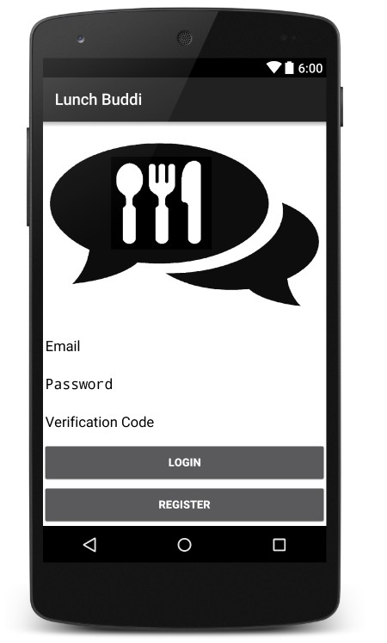
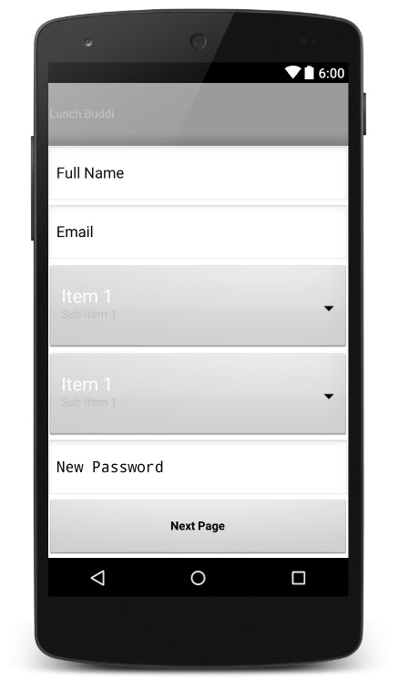
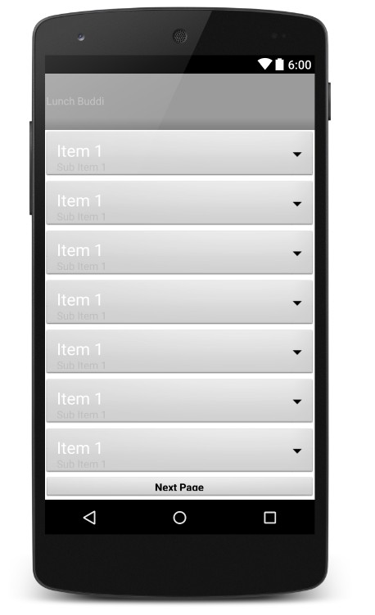
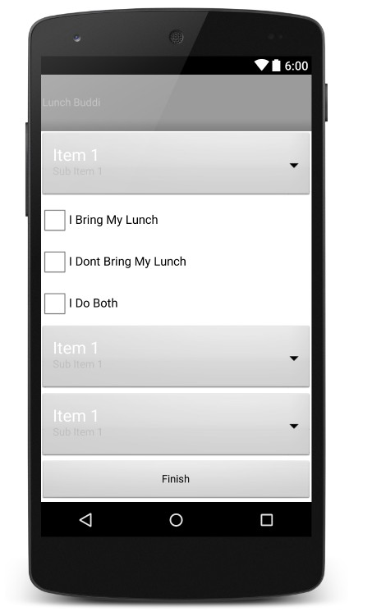
Completed (Navigable UI)

Slide 7
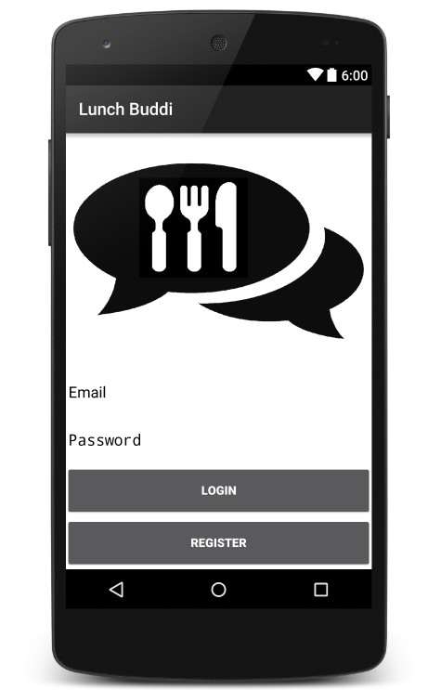
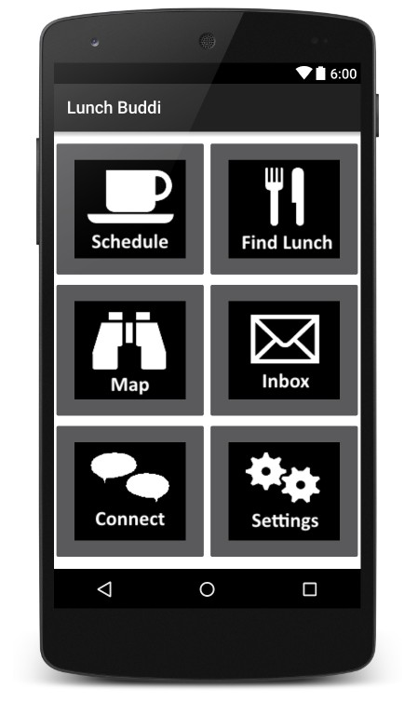
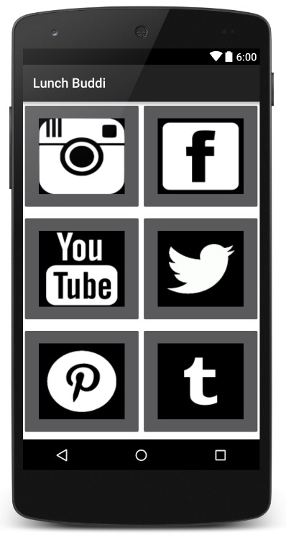
Completed (Navigable UI)

Slide 8
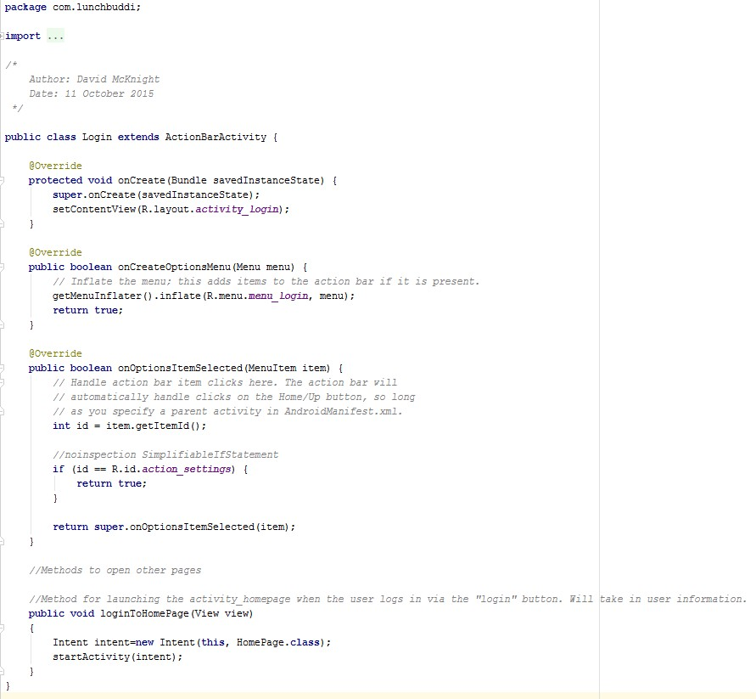
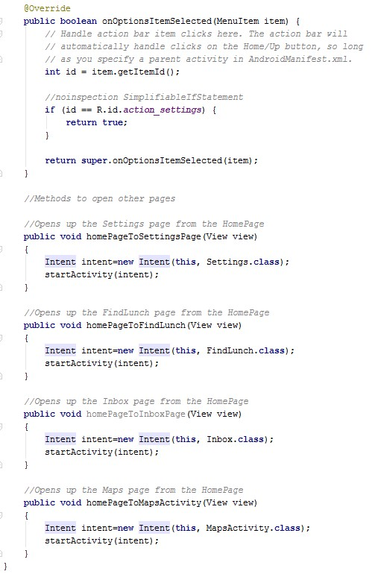
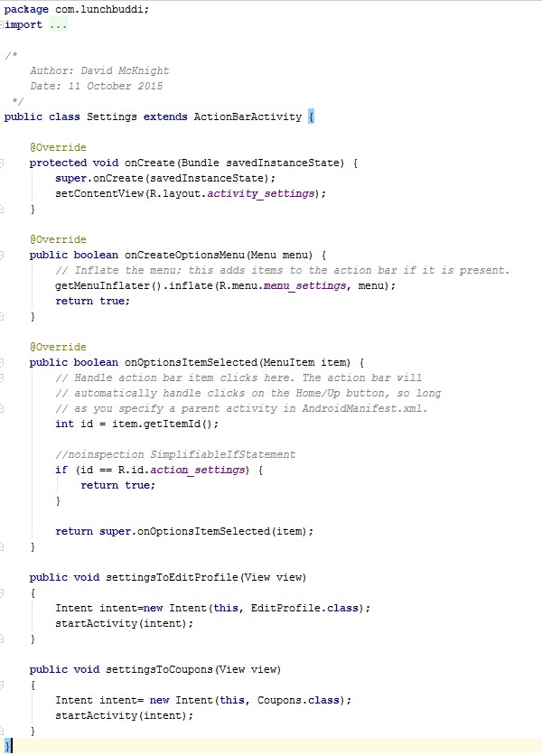
Completed (Navigable UI)

Slide 9
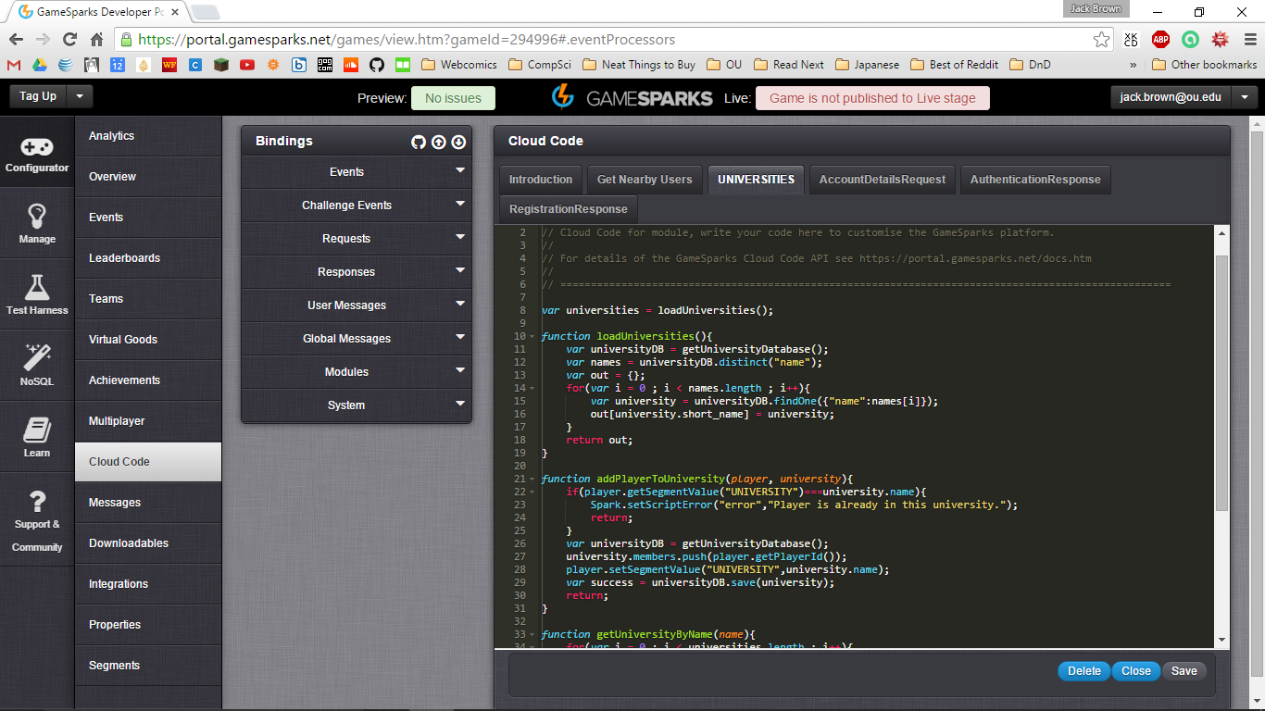
Completed (Basic Server Connection)
Chose a server.
Began connecting app to the server.
Programmed a model of how our network will interact.

Slide 10
In Progress (Research)
Research how and whether our app would affect retention rates at OU.
Created a survey to get public opinion of certain aspects of our app (not yet distributed).

Slide 11
To Do:
Finish fragments for UI.
Improve on layout and structure of UI.
Distribute surveys.
Implement algorithm (backend).
Continue to work on server.

Slide 12
Current Needs
Private code repository
Test devices running Android (not critical this semester)

Slide 13
Summary
15% of freshmen drop out, nationwide
Many students may not continue because they don’t feel connected
TagUp seeks to solve this problem by connecting students over food

Slide 14
Sources
http://colleges.usnews.rankingsandreviews.com/best-colleges/university-of-oklahoma-3184

